Slide 1

1) What do you see in the cartoon? Describe it.
2) What do you think it means?
3) Why do you think the artist created it?

Slide 2
What does it mean to be a citizen?
Citizen: A legally recognized member of a country.
What does being a citizen mean to you?

Slide 3
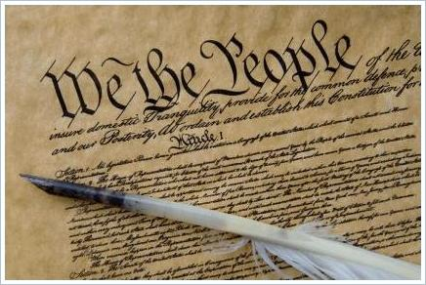
What does the Constitution of the United States Say about citizenship?
The Constitution is like a rule book for government: it outlines the structure and function of our government and names some of the rights of the people.

Slide 4
The Fourteenth Amendment
Defines citizens as “all persons born or naturalized in the United States”

Slide 5
Natural Born Citizens
Who is a natural born citizen of the United States?

Slide 6


Natural Born Citizenship is based on two “laws”:
“Law of Blood”
Children born to a parent or parents who are United States citizens.
“Law of Soil”
Children born in the United States or Territories/Possessions
S
B

Slide 7

“Law of the Blood”
Principle in which citizenship is determined by parentage rather than by place of birth.
The U.S. recognizes children born abroad to American citizens as citizens.

Slide 8

“Law of the Soil”
Any child born in the United States is a citizen of the United States, even if the child’s parents are not citizens.
Soil of the U.S. includes Puerto Rico, Guam, the Virgin Islands, and the Northern Mariana Islands.

Slide 9


To Sum It Up…
Law of Soil – WHERE you are born (must be within the United States or territory/possession)
Law of Blood – WHO you are born to
S
B

Slide 10
NATURALIZATION
How someone can become a citizen of the United States.

Slide 11
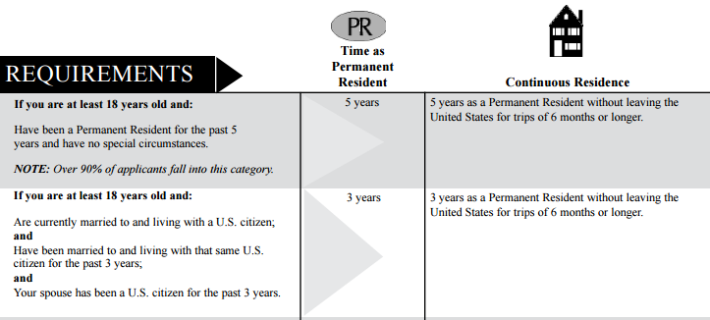
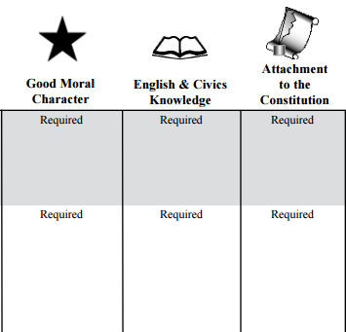
To Become a Naturalized Citizen…
There are special considerations for those who serve in the military or served during times of war/conflict.
Notes:
Go over the chart provided to explain the naturalization process. Permanent residents also must establish “continuous residence” in the U.S., meaning they cannot leave the country for trips longer than 6 months.

Slide 12
Defining Immigrants, Residents, and Aliens
Immigrant
Alien
A person who comes to live permanently in a foreign country.
A resident is someone who has been legally allowed to live in the United States, but is not a citizen
Any person not a citizen or national of the United States.
Resident

